Slide 1
Topic: Code conversions

Slide 2
What is meant by code?
The digital data is represented, stored and transmitted as group of binary bits. This group is also called as binary code. The binary code is represented by the number as well as alphanumeric letter.
Codes are classified in to 2 types
Weighted
Non-weighted

Slide 3
WEIGHTED CODE
In weighted code, each digit position has a weight or value.
The sum of all digits multiplied by a weight gives a total amount being represented.
BCD or 8421 is a type of weighted code where each digit position is assigned a specific weight.

Slide 4
NON WEIGHTED CODE
In non weighted code there is no positional weight
i.e., Each position within the binary number is not assigned a prefix value.
No specific positions are assigned to bit positions in non weighted code.
The non weighted codes are (1) Gray code
(2) Excess-3 code.

Slide 5
Code converters
Code conversion is used to change the data present in one type of binary code to another type of binary code. Some of the codes are BCD, Gray, Excess 3, ASCII and so on.
Some of the conversions are
Binary to Gray code conversion
Gray to Binary code conversion
BCD to Excess-3 code conversion
Excess-3 to BCD code conversion

Slide 6
Binary to Gray code conversion
The Gray code is non-weighted code, as the position of bit does not contain any weight. The Gray code is a reflective digital code which has the special property that any two subsequent numbers codes differ by only one bit. This is also called a unit- distance code.

Slide 7
The generation of 4-bit Gray code can be calculated by using formula.
G₁ = Β₁
G₂ = Β₁⊕Β₂
G₃ = Β₂⊕Β₃
G₄ = Β₃⊕Β₄

Slide 8
The most significant bit (MSB) of the Gray code is always equal to the MSB of the given binary code other bits of the output Gray code can be obtained by Xoring binary code bit at that index and previous index.
The binary to Gray code conversions can be done by using xoring logic gate. A four-bit binary code converter is shown above. The input is binary code and the output is equivalent Gray code.

Slide 9
A four-bit binary to Gray code conversion table is as shown below.
Four Bit Binary Number |  |  |  | Four Bit Gray Code
B₁ | B₂ | B₃ | B₄ | G₁ | G₂ | G₃ | G₄
0 | 0 | 0 | 0 | 0 | 0 | 0 | 0
0 | 0 | 0 | 1 | 0 | 0 | 0 | 1
0 | 0 | 1 | 0 | 0 | 0 | 1 | 1
0 | 0 | 1 | 1 | 0 | 0 | 1 | 0
0 | 1 | 0 | 0 | 0 | 1 | 1 | 0
0 | 1 | 0 | 1 | 0 | 1 | 1 | 1
0 | 1 | 1 | 0 | 0 | 1 | 0 | 1
0 | 1 | 1 | 1 | 0 | 1 | 0 | 0
1 | 0 | 0 | 0 | 1 | 1 | 0 | 0
1 | 0 | 0 | 1 | 1 | 1 | 0 | 1
1 | 0 | 1 | 0 | 1 | 1 | 1 | 1
1 | 0 | 1 | 1 | 1 | 1 | 1 | 0
1 | 1 | 0 | 0 | 1 | 0 | 1 | 0
1 | 1 | 0 | 1 | 1 | 0 | 1 | 1
1 | 1 | 1 | 0 | 1 | 0 | 0 | 1
1 | 1 | 1 | 1 | 1 | 0 | 0 | 0

Slide 10
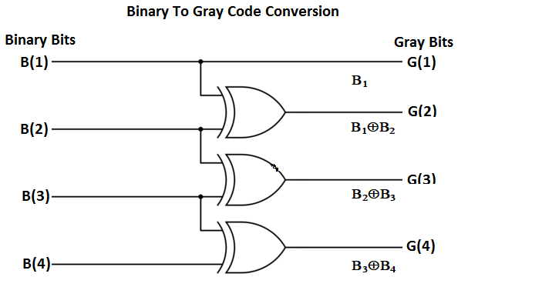
The circuit for Binary to Gray code conversion is

Slide 11
Gray to binary code conversion
In Gray to binary conversion, the input is Gray code and output is its equivalent binary code.
The generation of four-bit binary equivalent code can be calculated by using formula.
Β₁ = G₁
Β₂ = G₂ ⊕ Β₁
Β₃ = G₃ ⊕ Β₂
Β₄ = G₄ ⊕ Β₃

Slide 12
The MSB of binary code is similar to the MSB of Gray code.
To get next bit, use the xoring operation among the MSB of binary to the next bit of the Gray code.
Similarly, to get the third bit, it uses the xoring operation among the second bit to the third MSB of the Gray code and so on.

Slide 13
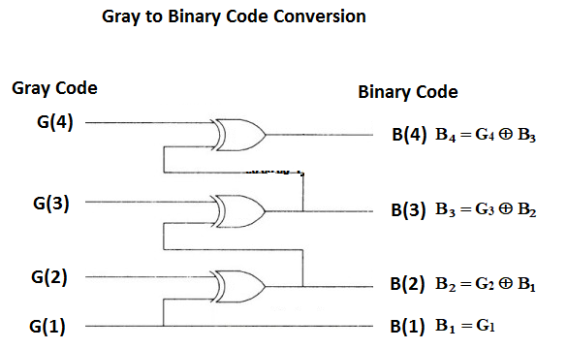
The Gray to binary conversion method can be done by using xoring logic gate.
A four-bit Gray to binary code converter is as shown below.

Slide 14
A four-bit Gray to binary code conversion table is as shown below.
Four Bit Gray Code |  |  |  | Four Bit Binary Number
G₁ | G₂ | G₃ | G₄ | B₁ | B₂ | B₃ | B₄
0 | 0 | 0 | 0 | 0 | 0 | 0 | 0
0 | 0 | 0 | 1 | 0 | 0 | 0 | 1
0 | 0 | 1 | 1 | 0 | 0 | 1 | 0
0 | 0 | 1 | 0 | 0 | 0 | 1 | 1
0 | 1 | 1 | 0 | 0 | 1 | 0 | 0
0 | 1 | 1 | 1 | 0 | 1 | 0 | 1
0 | 1 | 0 | 1 | 0 | 1 | 1 | 0
0 | 1 | 0 | 0 | 0 | 1 | 1 | 1
1 | 1 | 0 | 0 | 1 | 0 | 0 | 0
1 | 1 | 0 | 1 | 1 | 0 | 0 | 1
1 | 1 | 1 | 1 | 1 | 0 | 1 | 0
1 | 1 | 1 | 0 | 1 | 0 | 1 | 1
1 | 0 | 1 | 0 | 1 | 1 | 0 | 0
1 | 0 | 1 | 1 | 1 | 1 | 0 | 1
1 | 0 | 0 | 1 | 1 | 1 | 1 | 0
1 | 0 | 0 | 0 | 1 | 1 | 1 | 1

Slide 15
BCD to Excess 3 code
Excess-3 codes are unweighted and can be obtained by adding 3 to each decimal digit then it can be represented by using 4-bit binary number for each digit.
To find the decimal equivalent of the given binary number. Add 0011 to each four-bit group in binary coded decimal number (BCD) to get desired excess-3 equivalent.
The variables B₀, B₁, B₂, and B₃ represent the bits of the binary numbers.
The variable 'B₀' represents the LSB, and the variable 'B₃' represents the MSB.
The variables E₀, E₁, E₂, and E₃ represent the bits of the Excess-3 code.
The variable 'E₀' represents the LSB, and the variable 'E₃' represents the MSB.

Slide 16
The truth table for BCD to Excess-3 code converter can be determined as shown in table below.
For impossible four bit Excess-3 code we use output as Don’t care conditions. The 'don't care conditions' is defined by the variable 'X'.
 | BCD Number |  |  |  | Excess-3 Code Number
Decimal | B₃ | B₂ | B₁ | B₀ | E₃ | E₂ | E₁ | E₀
0 | 0 | 0 | 0 | 0 | 0 | 0 | 1 | 1
1 | 0 | 0 | 0 | 1 | 0 | 1 | 0 | 0
2 | 0 | 0 | 1 | 0 | 0 | 1 | 0 | 1
3 | 0 | 0 | 1 | 1 | 0 | 1 | 1 | 0
4 | 0 | 1 | 0 | 0 | 0 | 1 | 1 | 1
5 | 0 | 1 | 0 | 1 | 1 | 0 | 0 | 0
6 | 0 | 1 | 1 | 0 | 1 | 0 | 0 | 1
7 | 0 | 1 | 1 | 1 | 1 | 0 | 1 | 0
8 | 1 | 0 | 0 | 0 | 1 | 0 | 1 | 1
9 | 1 | 0 | 0 | 1 | 1 | 1 | 0 | 0

Slide 17
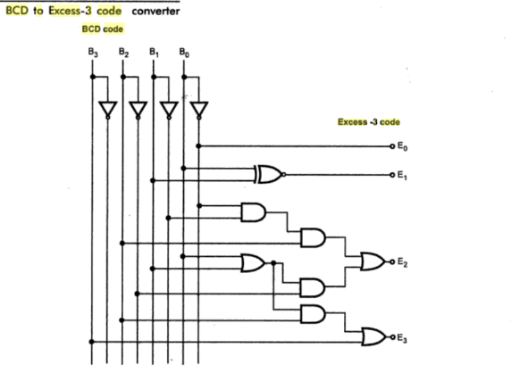
The circuit diagram for BCD to Excess-3 code converter is shown below

Slide 18
Excess-3 to BCD converter
The process of converting Excess-3 to BCD is opposite to the process of converting BCD to Excess-3.
The BCD code can be calculated by subtracting 3, i.e., 0011 from each four-digit Excess-3 code.
The variables E₀, E₁, E₂, and E₃ represent the bits of the Excess-3 code.
The variable 'E₀' represents the LSB, and the variable 'E₃' represents the MSB.
The variables B₀, B₁, B₂, and B₃ represent the bits of the binary numbers.
The variable 'B₀' represents the LSB, and the variable 'B₃' represents the MSB.
The 'don't care conditions' is defined by the variable 'X'.

Slide 19
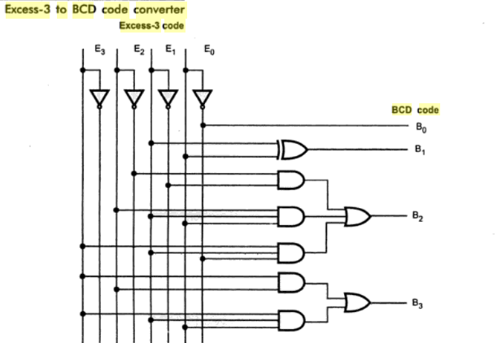
The circuit diagram for Excess-3 code to BCD converter is shown below

Slide 20
The truth table for BCD to Excess-3 code converter can be determined as shown in table below.
 | Excess-3 Code Number |  |  |  | BCD Number
Decimal | E₃ | E₂ | E₁ | E₀ | B₃ | B₂ | B₁ | B₀
0 | 0 | 0 | 1 | 1 | 0 | 0 | 0 | 0
1 | 0 | 1 | 0 | 0 | 0 | 0 | 0 | 1
2 | 0 | 1 | 0 | 1 | 0 | 0 | 1 | 0
3 | 0 | 1 | 1 | 0 | 0 | 0 | 1 | 1
4 | 0 | 1 | 1 | 1 | 0 | 1 | 0 | 0
5 | 1 | 0 | 0 | 0 | 0 | 1 | 0 | 1
6 | 1 | 0 | 0 | 1 | 0 | 1 | 1 | 0
7 | 1 | 0 | 1 | 0 | 0 | 1 | 1 | 1
8 | 1 | 0 | 1 | 1 | 1 | 0 | 0 | 0
9 | 1 | 1 | 0 | 0 | 1 | 0 | 0 | 1

Slide 21
